Slide 1
Bayesian Inference for Sequential Interim Analysis in Pfizer COVID Vaccine Clinical Trial
Team Blue
Dehua Bi, Jiaming Hu, Xinxin Chen, Jin Sung Kim, Kenny Shaevel

Slide 2
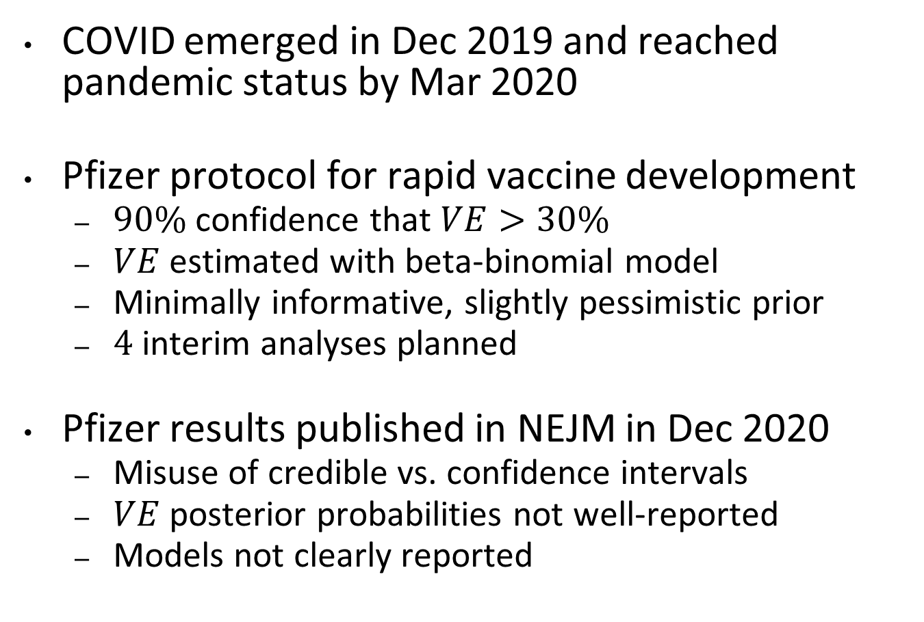
Background
COVID emerged in Dec 2019 and reached pandemic status by Mar 2020
Pfizer protocol for rapid vaccine development
$90\%$ confidence that $VE>30\%$
$VE$ estimated with beta-binomial model
Minimally informative, slightly pessimistic prior
$4$ interim analyses planned
Pfizer results published in NEJM in Dec 2020
Misuse of credible vs. confidence intervals
$VE$ posterior probabilities not well-reported
Models not clearly reported

Slide 3
Approach
Objective: simulate vaccine approvals in the future using Bayesian sequential decision making
Based on Berry (1987), with recommendations by Harrell (2017) and Ji/Yuan (2020)
Benchmark results of Bayesian approach to results of Frequentist approach

Slide 4
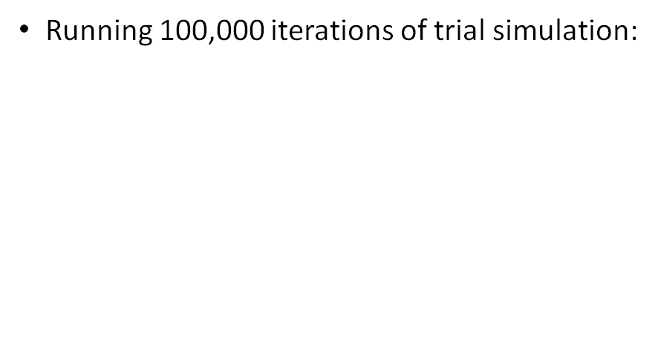
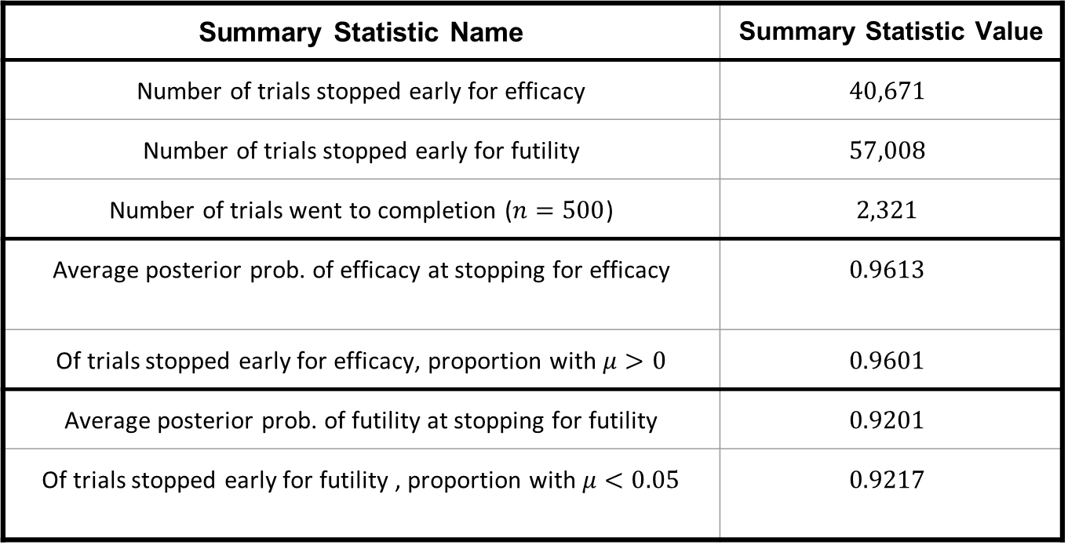
Frank Harrell Code Simulation
Summary Statistic Name | Summary Statistic Value
Number of trials stopped early for efficacy | $$40,671$$
Number of trials stopped early for futility | $$57,008$$
Number of trials went to completion ($n=500$) | $$2,321$$
Average posterior prob. of efficacy at stopping for efficacy | $$0.9613$$
Of trials stopped early for efficacy, proportion with $μ>0$ | $$0.9601$$
Average posterior prob. of futility at stopping for futility | $$0.9201$$
Of trials stopped early for futility , proportion with $μ<0.05$ | $$0.9217$$

Slide 5
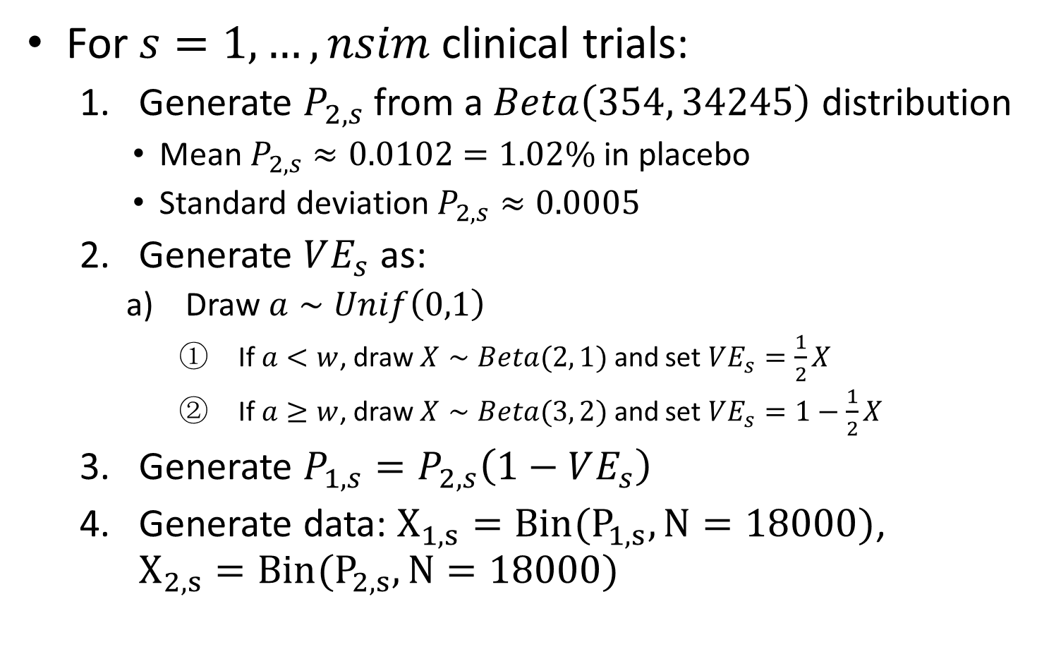
Generative Model

Slide 6
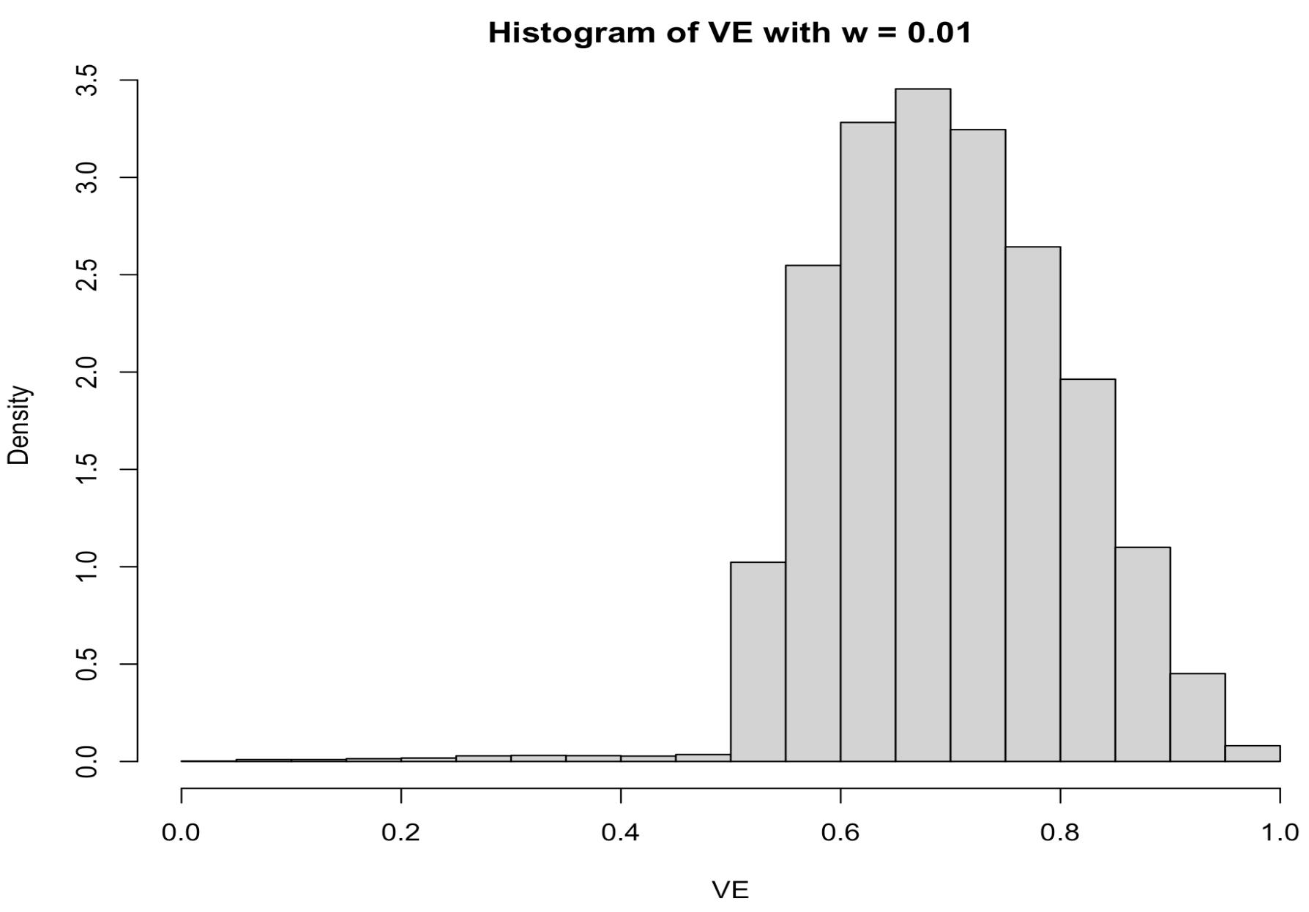
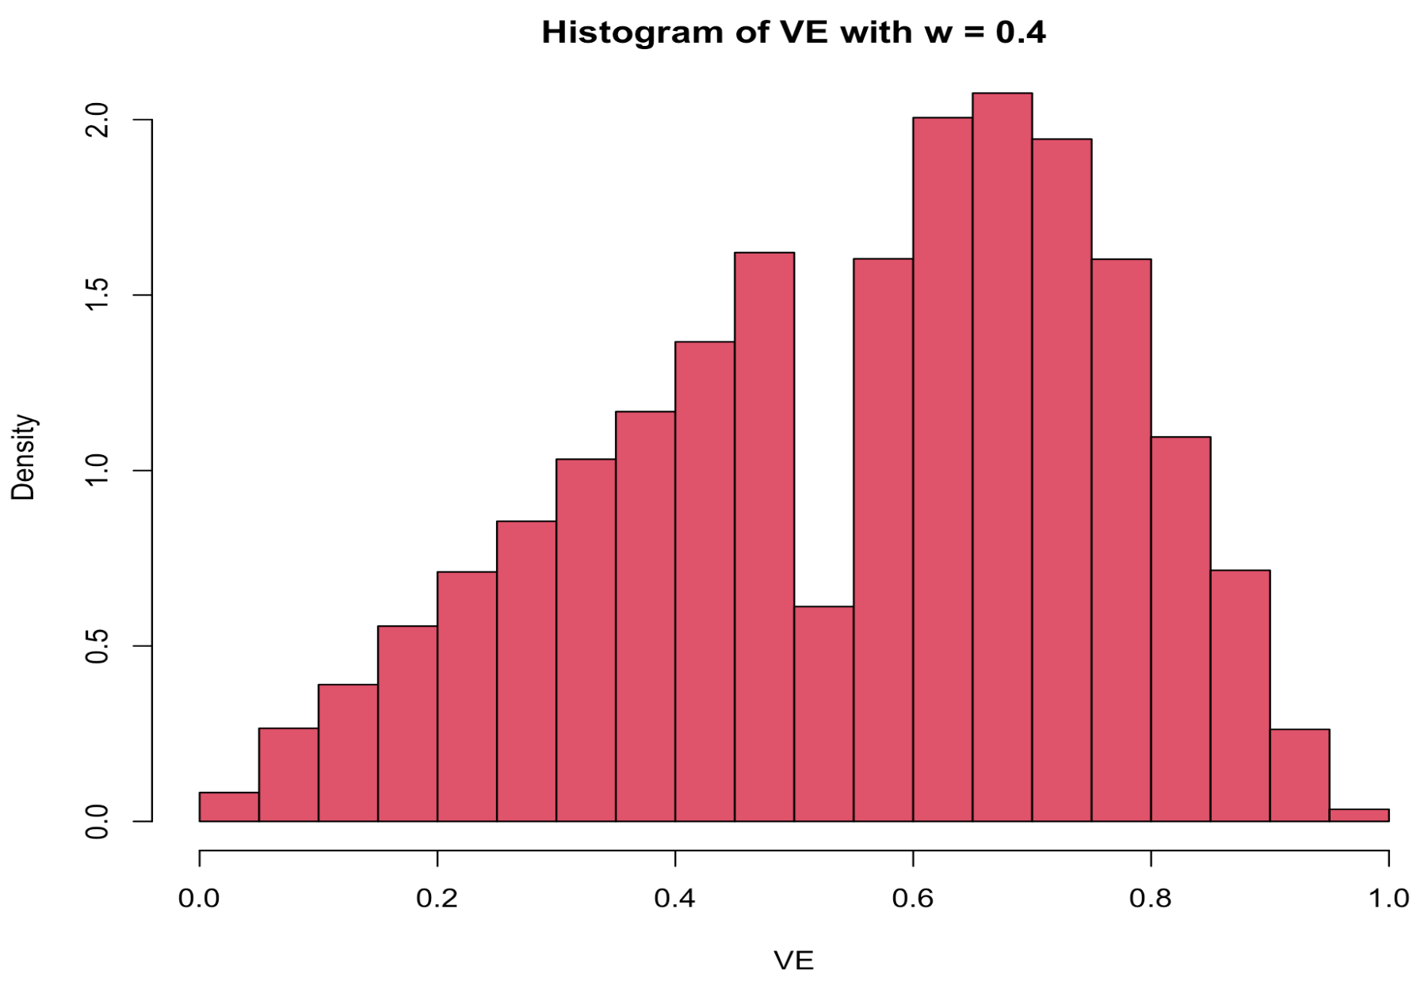
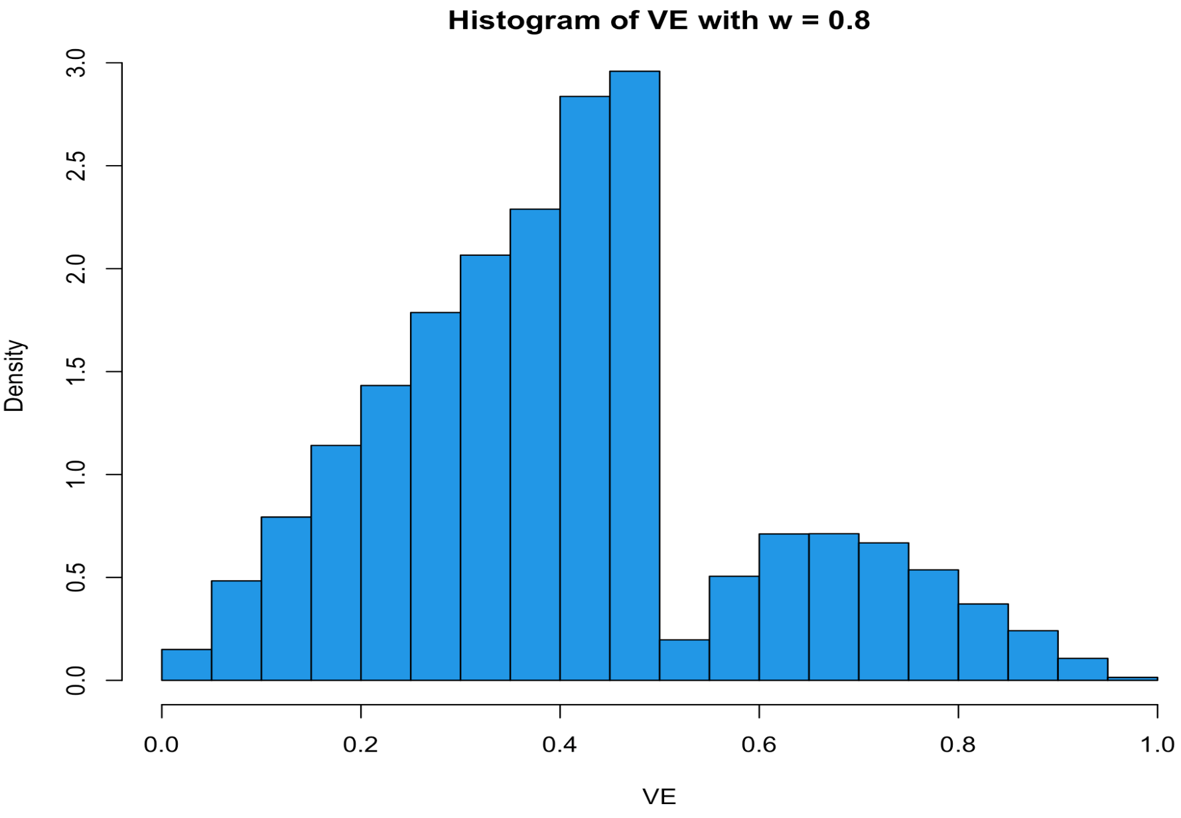
Prior of VE with various w

Slide 7
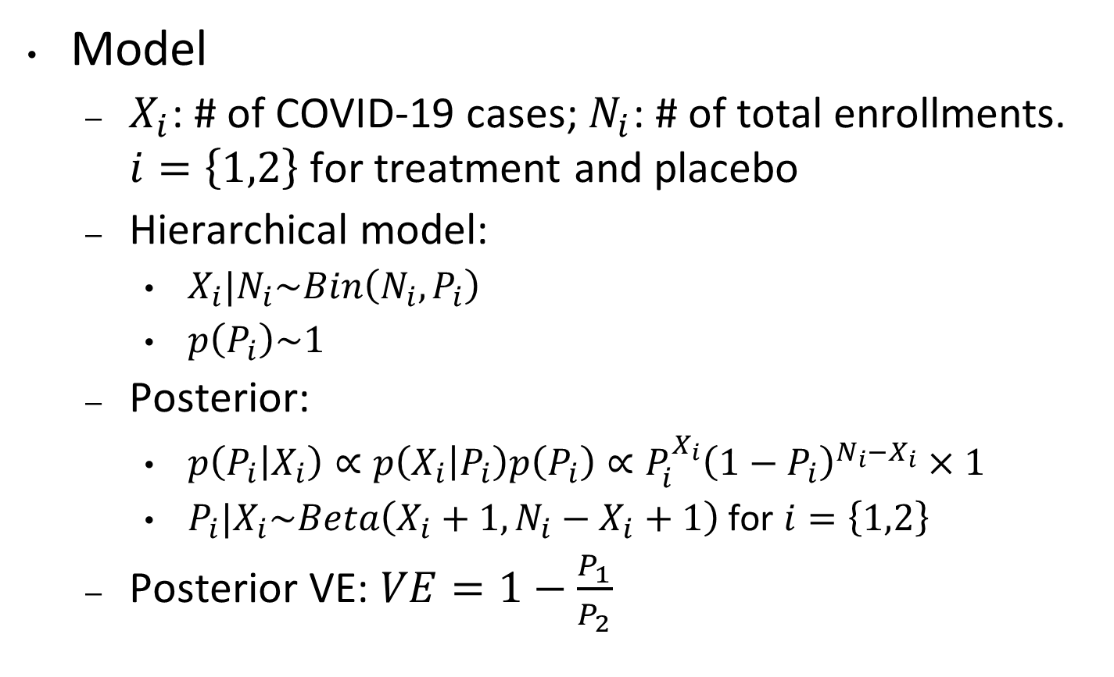
Bayesian Framework Model
Model
$X_{i}$: # of COVID-19 cases; $N_{i}$: # of total enrollments. $i=\left\{1,2\right\}$ for treatment and placebo
Hierarchical model:
$X_{i}|N_{i}\sim Bin\left(N_{i},P_{i}\right)$
$p\left(P_{i}\right)\sim 1$
Posterior:
$p\left(P_{i} | X_{i}\right)∝p\left(X_{i} | P_{i}\right)p\left(P_{i}\right)∝P_{i}^{X_{i}}{\left(1−P_{i}\right)}^{N_{i}−X_{i}}×1$
$P_{i}|X_{i}\sim Beta\left(X_{i}+1,N_{i}−X_{i}+1\right)$ for $i=\left\{1,2\right\}$
Posterior VE: $VE=1−\frac{P_{1}}{P_{2}}$

Slide 8
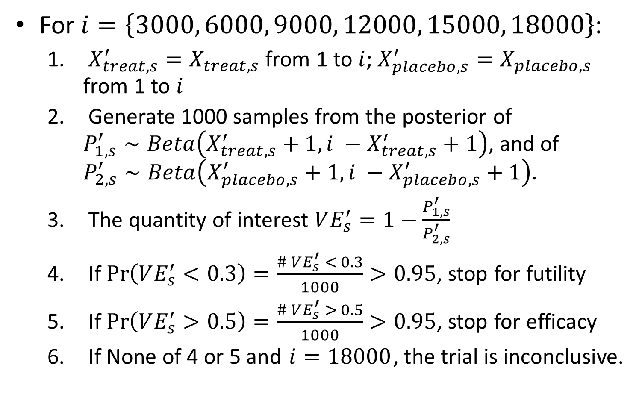
Sequential Bayesian Scheme

Slide 9
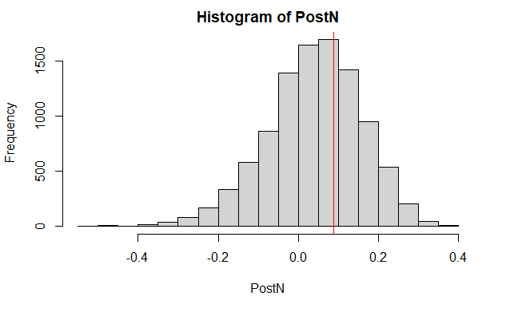
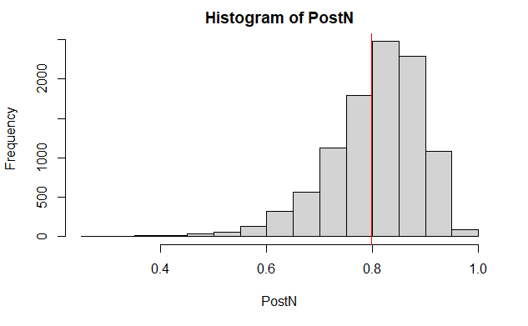
Posterior of a Single Trial
Posterior VE of a Efficacy trial
Posterior VE of a futility trial

Slide 10
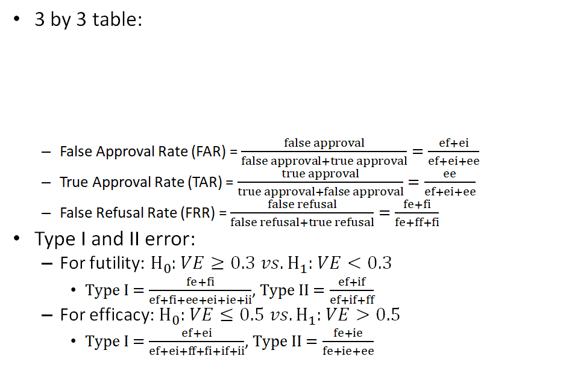
Some Key Summary Statistics
Estimate\Truth | Efficacy | Futility | Inconclusive
Efficacy | ee | ef | ei
Futility | fe | ff | fi
Inconclusive | ie | if | ii

Slide 11

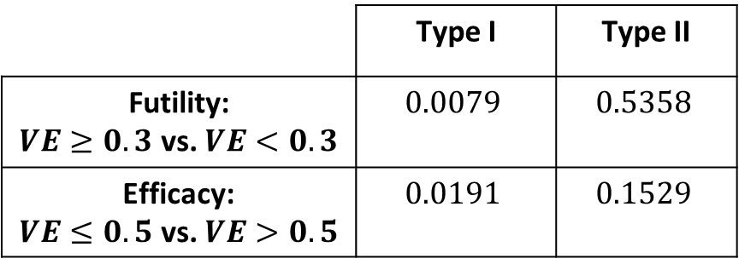
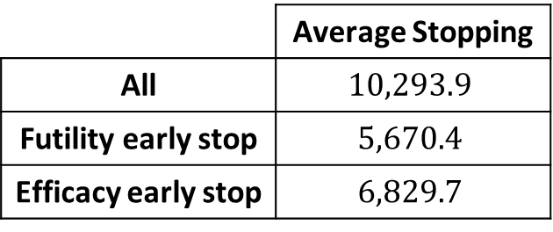
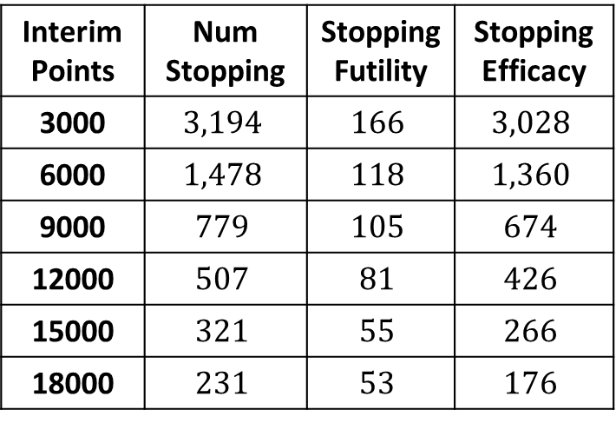
Bayesian Statistical Results
Rates and Errors:
Number of trials with early stopping for efficacy and futility are $5,754$ and $525$
Interim stopping:
 | Type I | Type II
Futility: $VE≥0.3$ vs. $VE<0.3$ | $$0.0079$$ | $$0.5358$$
Efficacy: $VE≤0.5$ vs. $VE>0.5$ | $$0.0191$$ | $$0.1529$$
FAR | 0.0110
TAR | 0.9890
FRR | 0.1228
Interim Points | Num Stopping | Stopping Futility | Stopping Efficacy
3000 | $$3,194$$ | $$166$$ | $$3,028$$
6000 | $$1,478$$ | $$118$$ | $$1,360$$
9000 | $$779$$ | $$105$$ | $$674$$
12000 | $$507$$ | $$81$$ | $$426$$
15000 | $$321$$ | $$55$$ | $$266$$
18000 | $$231$$ | $$53$$ | $$176$$
 | Average Stopping
All | $$10,293.9$$
Futility early stop | $$5,670.4$$
Efficacy early stop | $$6,829.7$$

Slide 12
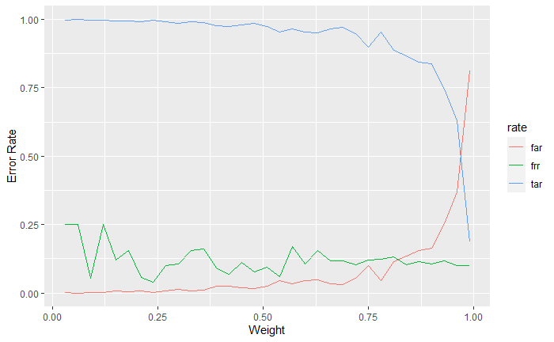
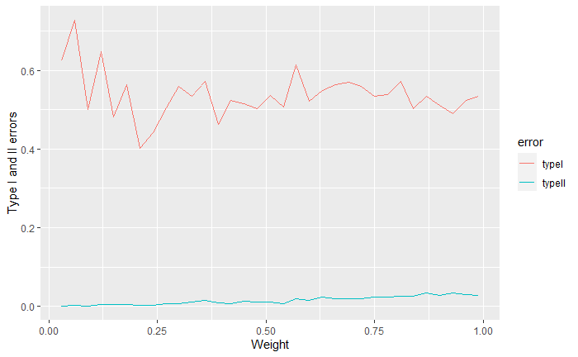
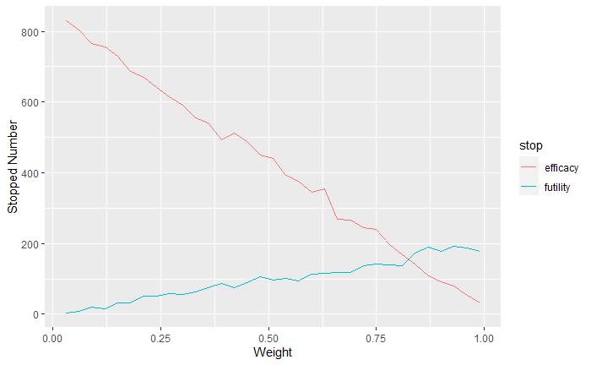
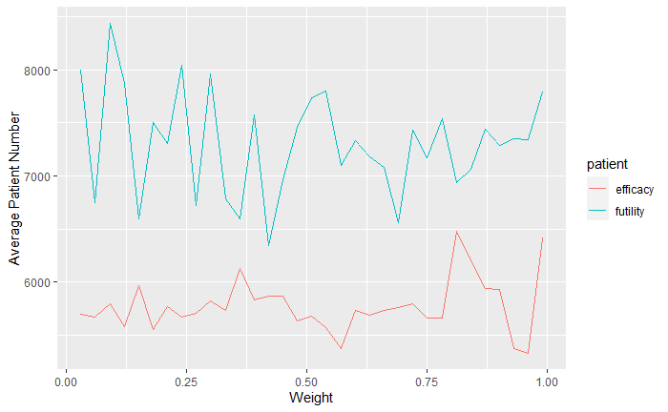

Simulation with various weights $w$

Slide 13
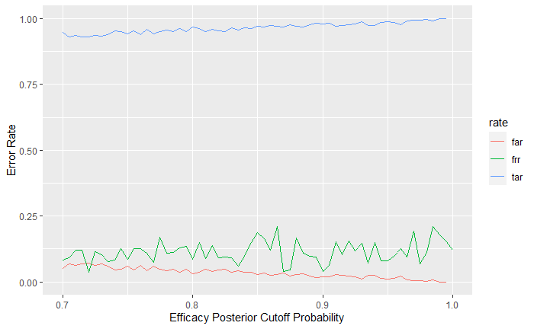
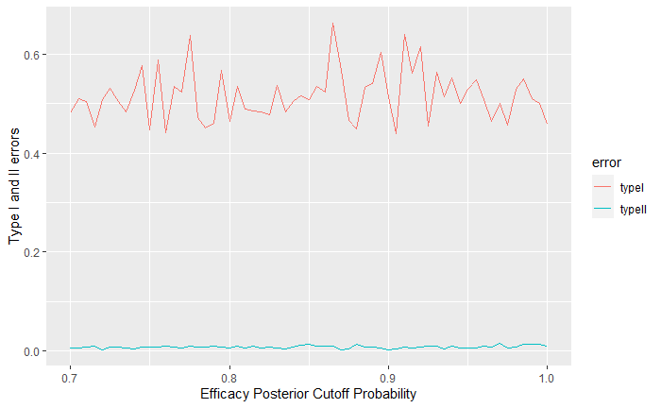
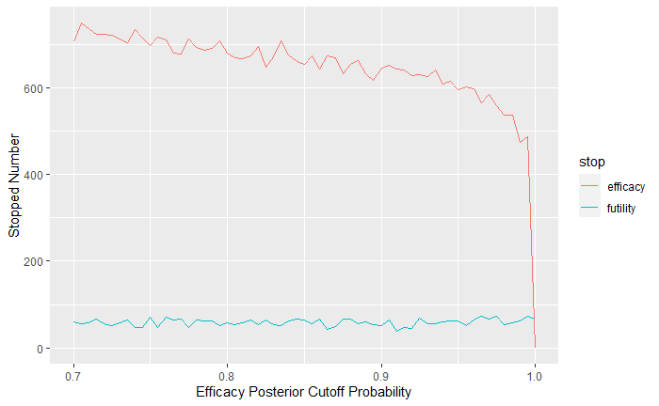
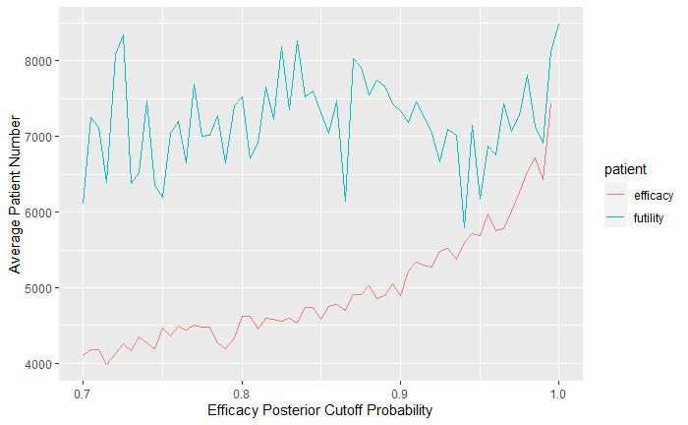
Simulation with various cut for Efficacy

Slide 14
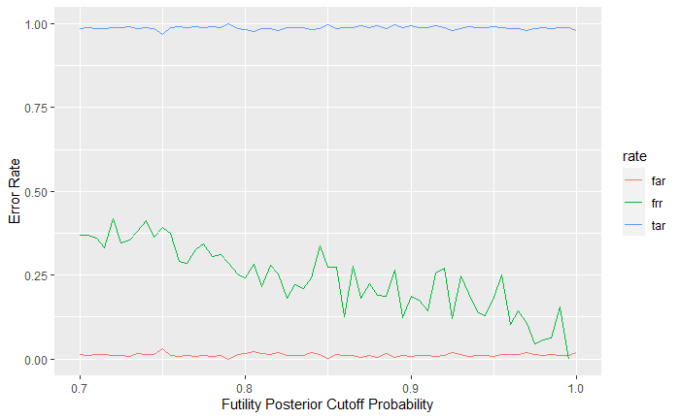
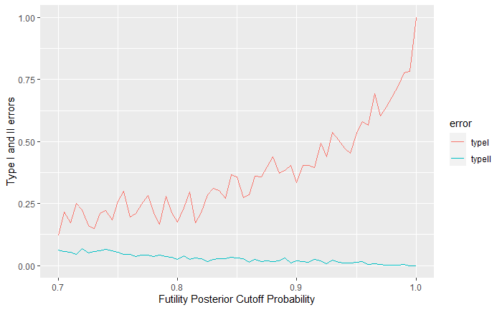
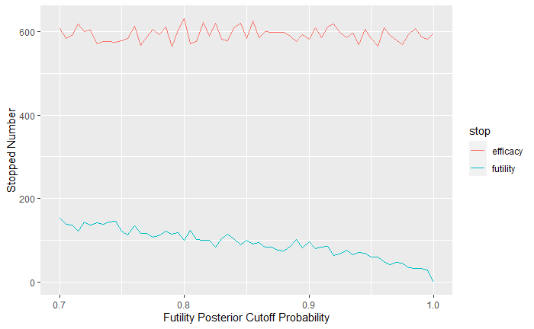
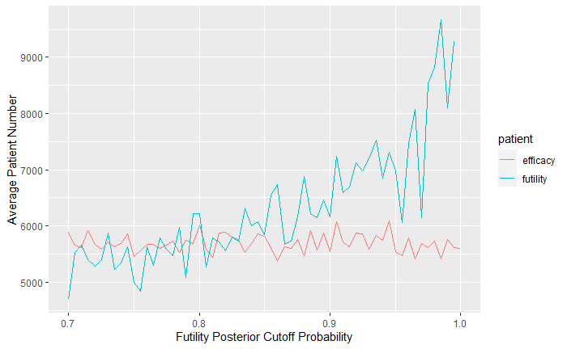
Simulation with various cut for Futility

Slide 15
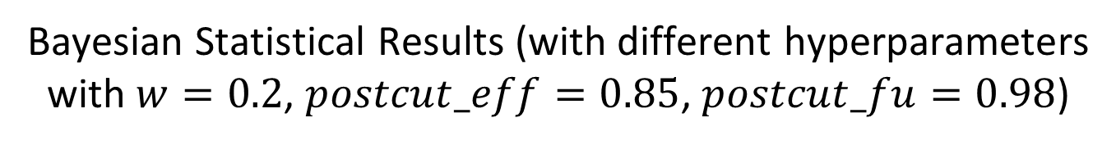
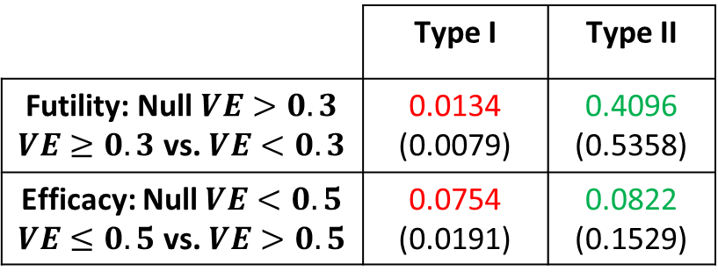
Bayesian Statistical Results (with different hyperparameters
with $w=0.2$, $postcut_eff=0.85$, $postcut_fu=0.98$)
Number of trials with early stopping for efficacy and futility: 7375(6115) and 243(500)
Interim stopping:
 | Type I | Type II
Futility: Null $VE>0.3$ $VE≥0.3$ vs. $VE<0.3$ | 0.0134 (0.0079) | 0.4096 (0.5358)
Efficacy: Null $VE<0.5$ $VE≤0.5$ vs. $VE>0.5$ | 0.0754 (0.0191) | 0.0822 (0.1529)
FAR | 0.0190(0.0110)
TAR | 0.9800(0.9890)
FRR | 0.0729(0.1228)
Interim Points | Num Stopping | Stopping Futility | Stopping Efficacy
3000 | 4988(3194) | 54(166) | 4934(3028)
6000 | 1383(1478) | 55(118) | 1328(1360)
9000 | 599(779) | 44(105) | 555(674)
12000 | 417(507) | 56(81) | 361(426)
15000 | 231(321) | 34(55) | 197(266)
18000 | 2382(3721) | 31(53) | 129(176)
 | Average Stopping
All | 8000(10293.9)
Futility early stop | 8518.5(6829.7)
Efficacy early stop | 4752 (5670.4)

Slide 16
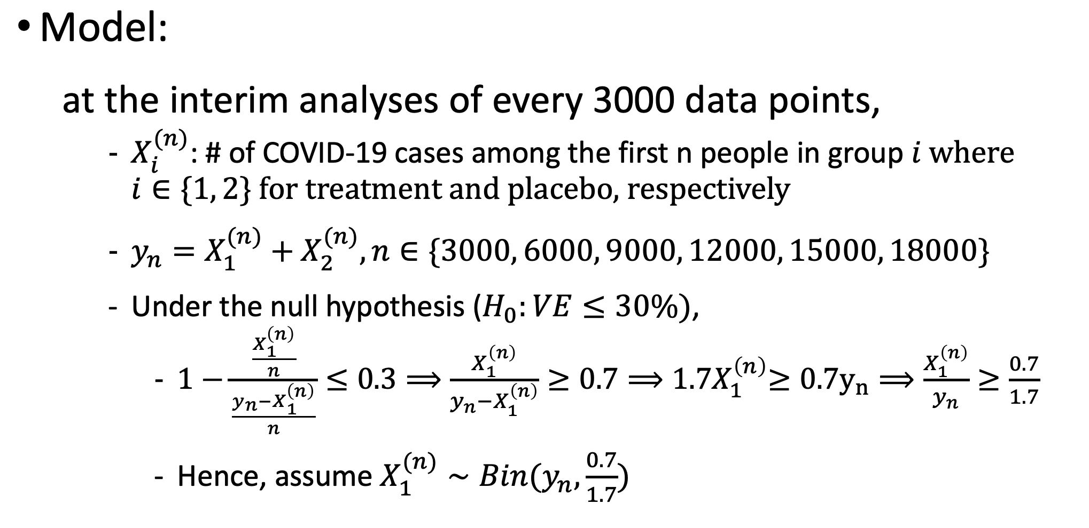
Frequentist Framework

Slide 17
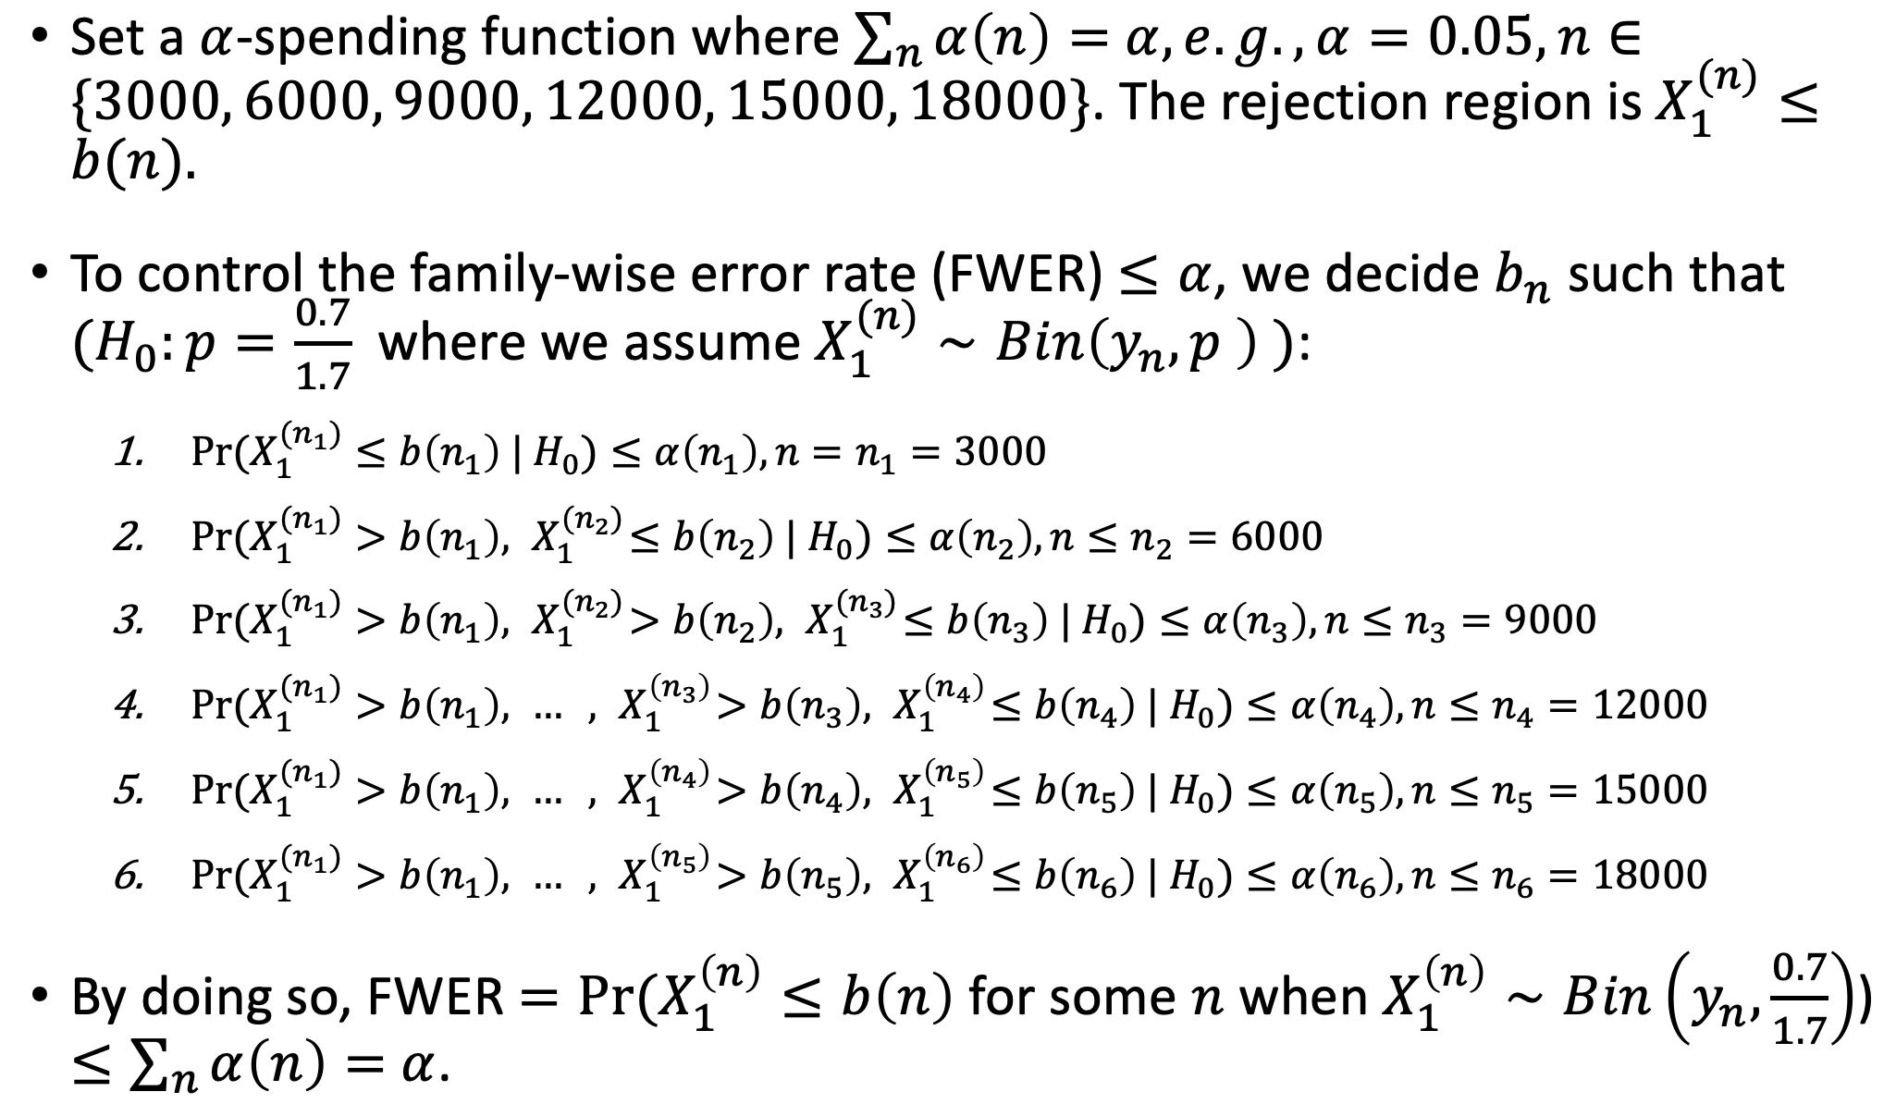
Frequentist Interim Analyses
Notes:
Step 1 means making false rejections at the first interim analysis; step 2 means not making false rejections at the first interim analysis but making false rejections at the second interim analysis; step 3 means not making false rejections at the first and the second interim analyses but making false rejections at the third interim analysis; ...

Slide 18
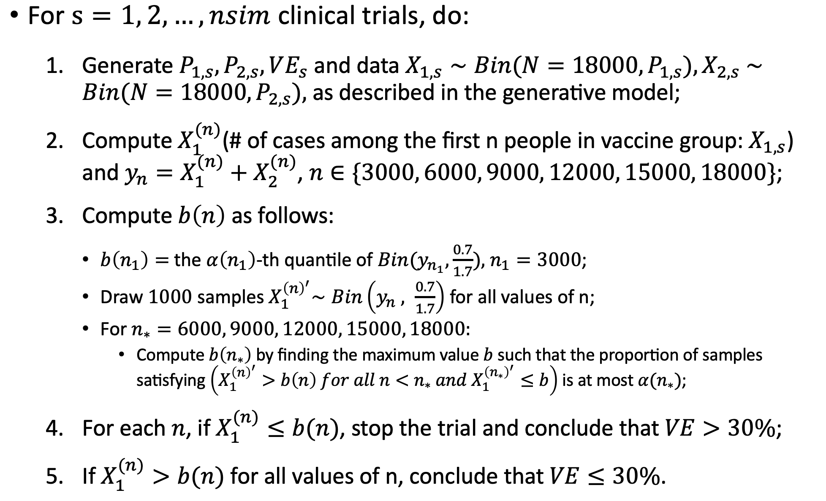
Algorithm

Slide 19
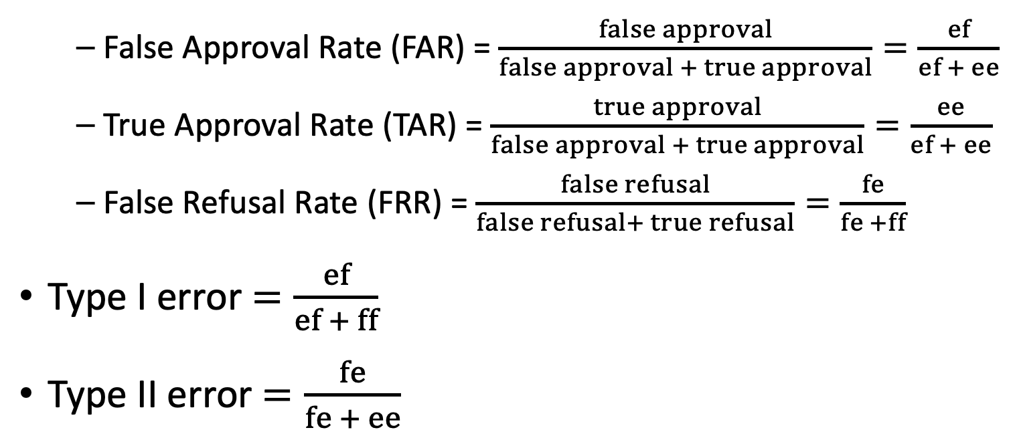
Some Key Summary Statistics
2 by 2 table:
Estimate\Truth | VE > 30% | VE <= 30%
VE > 30% | ee | ef
VE <= 30% | fe | ff

Slide 20
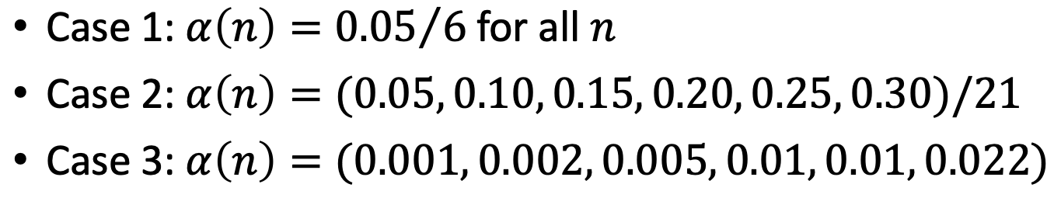
Frequentist Statistical Results
Consider 3 different alpha bounds:
Rates, errors and average sample sizes:
 | FAR | TAR | FRR | Type I Error | Type II Error | Avg. Sample Size | Avg. Sample Size (Early Stopping)
Case 1 | 0.0011 | 0.9989 | 0.5815 | 0.0073 | 0.1708 | 8954 | 5423
Case 2 | 0.0013 | 0.9987 | 0.5879 | 0.0097 | 0.1631 | 9396 | 6188
Case 3 | 0.0011 | 0.9989 | 0.5451 | 0.0070 | 0.1527 | 9978 | 6790

Slide 21
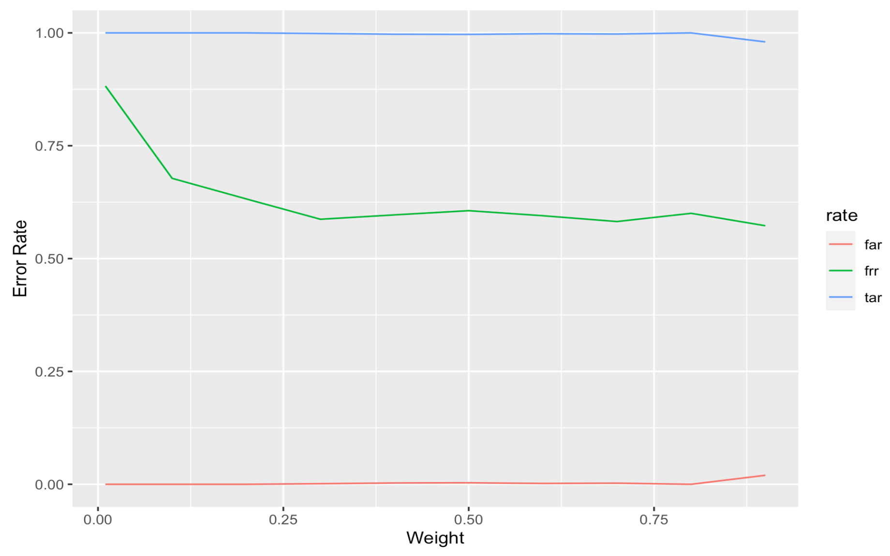
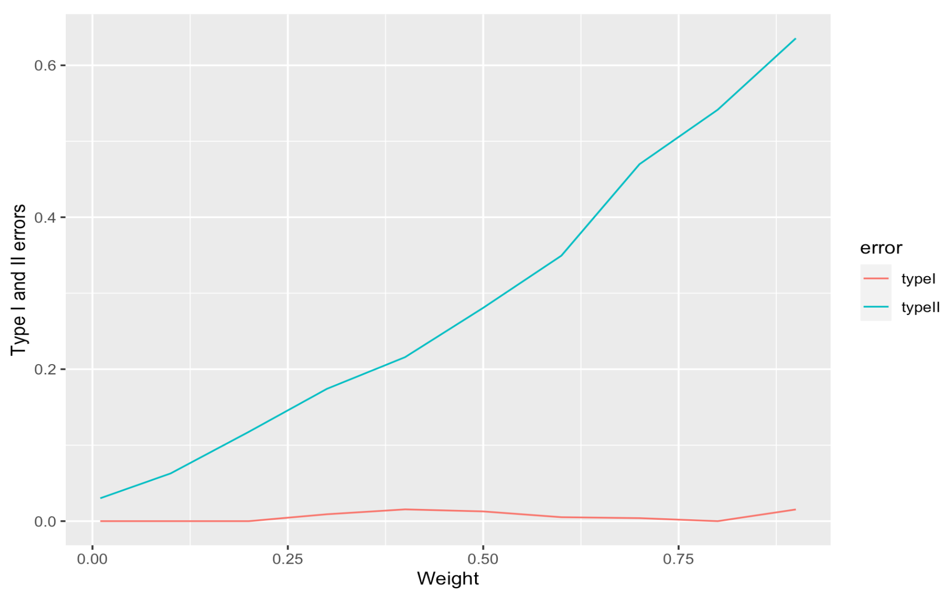
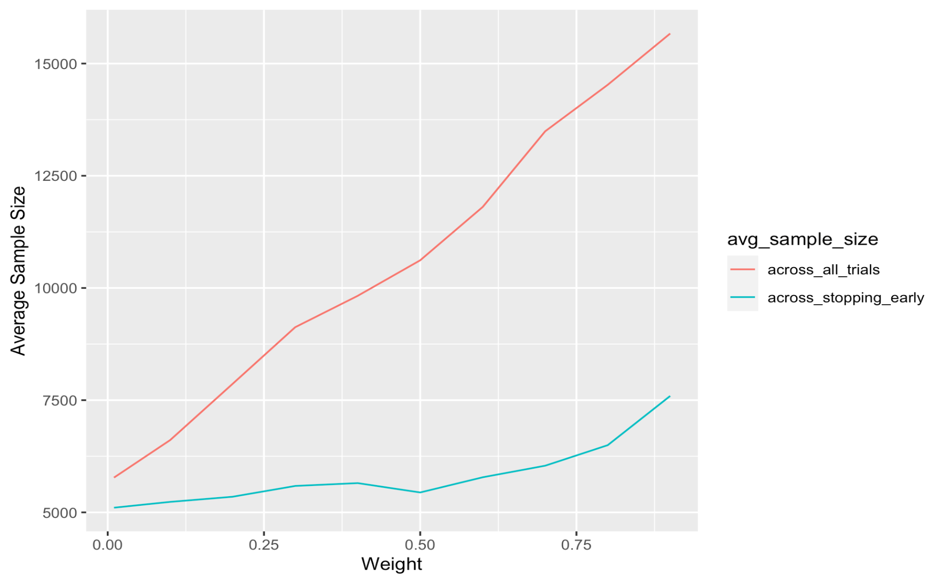
Simulation with various weights w
For each value of the weight w, the results are computed from 1000 simulated trials with constant alpha bounds.
Notes:
Use the constant alpha bounds

Slide 22
Naïve comparison
Bayesian
Frequentist
 | Efficacy (VE >0.3) | Futility (VE > 0.5) | Incon. (0.3 < VE < 0.5)
Efficacy | ee | ef | ei
Futility | fe | ff | fi
Incon. | ie | if | ii
 | Efficacy (VE > 0.3) | Futility (VE < 0.3)
Efficacy | ee | ef
Futility | fe | ff
FAR | 0.011
TAR | 0.989
FRR | 0.123
FAR | 0.001
TAR | 0.999
FRR | 0.582
Question: How do we compare these summary statistics?

Slide 23


Problems with Comparisons
Bayesian
Frequentist
Accept drug if:
$$P(VE>0.5|Data)>0.95$$
Stop for futility or efficacy.
Accept drug if:
$$P(Data|VE=0.3)<0.05$$
Stop for efficacy only.
Two differences in approach that prevent direct comparison:
Different cutoffs
Bayesian approach requires stricter threshold for efficacy
Different philosophies
Conditioning on data versus conditioning on hypothesis
Unclear that FARs (e.g.) should be on same scale, especially since the frequentist bound is not tight due to Bonferroni.

Slide 24
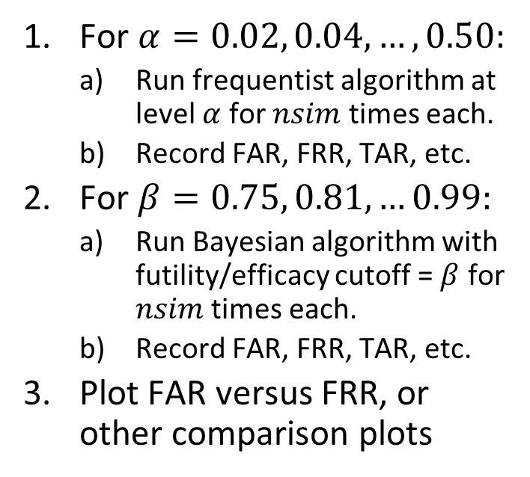
Approaching Apples-to-Apples
Solution 1
Solution 2
Change efficacy bound for Bayesian from 0.5 to 0.3
Compare approaches directly in FAR/FRR space
For $α=0.02, 0.04,…, 0.50:$
Run frequentist algorithm at level $α$ for $nsim$ times each.
Record FAR, FRR, TAR, etc.
For $β=0.75, 0.81, …0.99:$
Run Bayesian algorithm with futility/efficacy cutoff = $β$ for $nsim$ times each.
Record FAR, FRR, TAR, etc.
Plot FAR versus FRR, or other comparison plots
 | Efficacy (VE >0.3) | Futility (VE > 0.5) | Incon. (0.3 < VE < 0.5)
Efficacy | ee | ef | ei
Futility | fe | ff | fi
Incon. | ie | if | ii
 | Efficacy (VE > 0.3) | Futility (VE < 0.3)
Efficacy | ee | ef
Futility | fe | ff
Incon. | ie | if
Approve
Refuse*

Slide 25
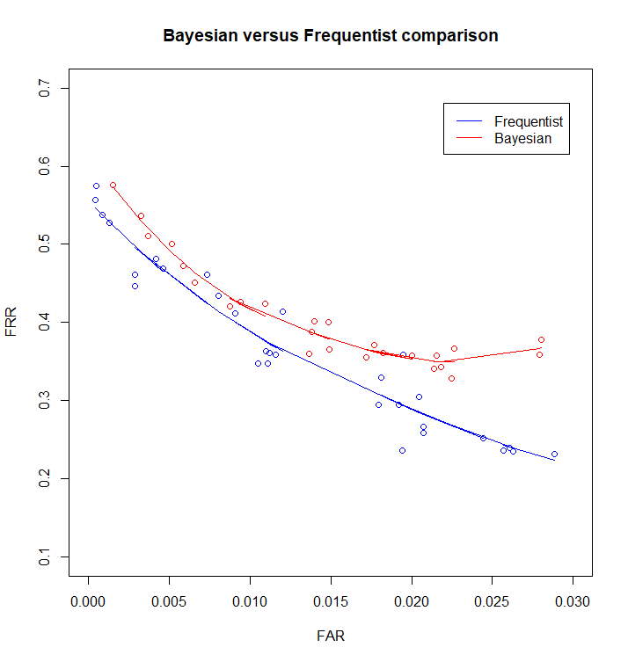
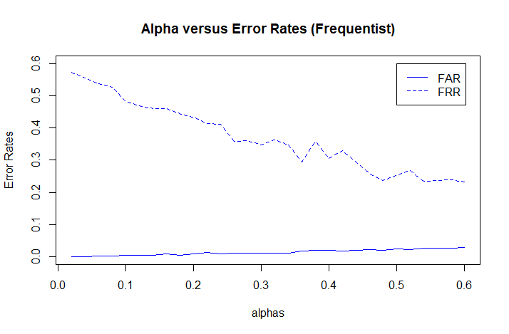
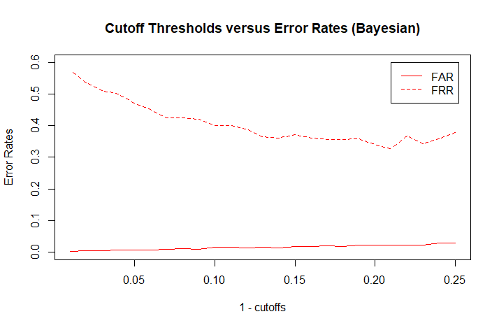
FAR & FRR Comparison

Slide 26
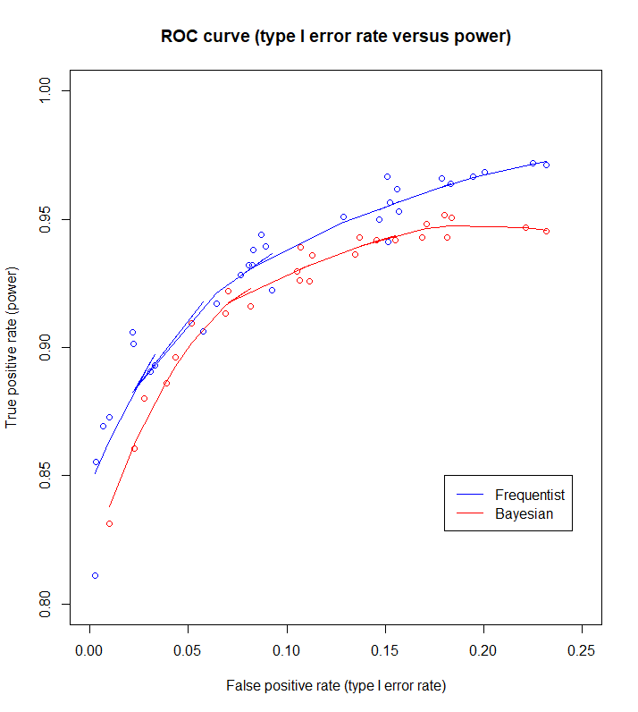
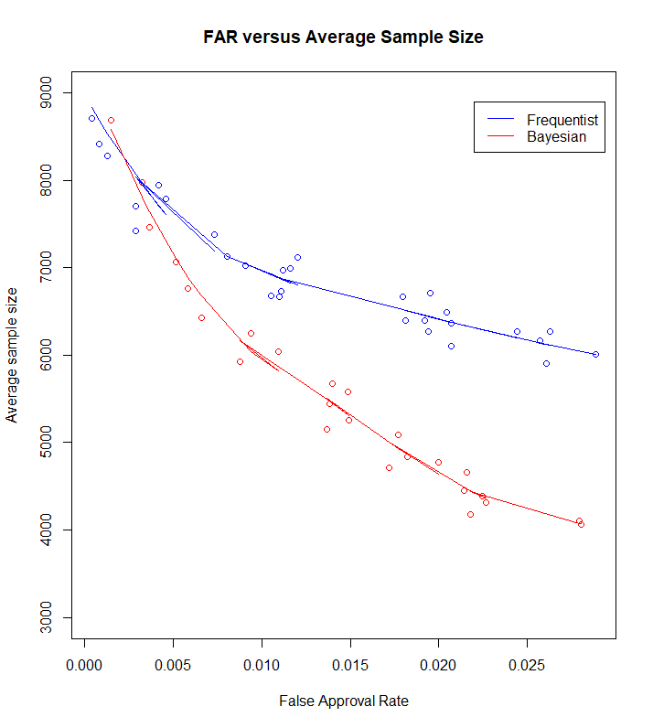
Sample Size and ROC

Slide 27
Questions/Discussion

